Slide 1
A seminar on Semantic and Sentimental Analysis.
By Shrirang Rajendra Mhalgi.
T.E. B
Roll No T150394324

Slide 2
Table of contents.
Introduction.
Semantic Analysis.
Sentimental Analysis.
Applications of Semantics and Sentimental Analysis.

Slide 3
Introduction : Overview
Human language is special for several reasons. It is specifically constructed to convey the speaker/writers meaning.
Human language is all about symbols
This means that you can convey the same meaning by using different ways, like speech, gesture, signs etc.
The encoding of these by the human brain is a continuous pattern of activation, where the symbols are transmitted via continuous signals of sound and vision.

Slide 4
Introduction : Overview
Understanding human language is considered a difficult task due to its complexity.
For example, there is an infinite number of different ways to arrange words in a sentence.
Also, words can have several meanings and contextual information is necessary to correctly interpret sentences.
So understanding and analysing language is not a difficult task.

Slide 5
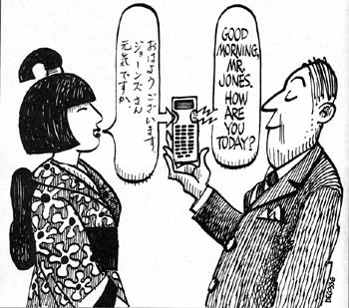
Introduction : Natural Language
Language is defined as the method of human communication, either spoken or written, consisting of the use of words in a structured and conventional way.
Natural language means a human language.
For example, English, French, Hindi and Chinese are natural languages. Computer languages, such as FORTRAN and C, are not.
Probably the single most challenging problem in computer science is to develop computers that can understand natural languages.
Fourth Generation Languages are the programming languages closest to natural languages.

Slide 6
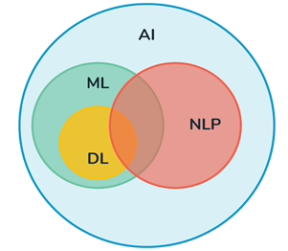
Introduction : Natural Language Processing
Natural language processing (NLP) is an area of computer science and artificial intelligence that is concerned with the interaction between computers and humans in natural language.
The goal of NLP is to enable computers to understand language as well as we do.
It is the driving force behind things like virtual assistants, speech recognition, sentiment analysis, automatic text summarization, machine translation and much more.
NLP is all about enabling computers to understand and generate human language. Applications of NLP techniques are Voice Assistants like Alexa and Siri but also things like Machine Translation and text-filtering.

Slide 7
Introduction : Natural Language Processing
Types of Natural Language Processing :
Optical Character Recognition : Converting written or printed text into data.
Speech Recognition : Converting spoken words into data.
Machine Translation : Translating text from one language to another.
Natural Language Generation : Formatting information as a natural language. For example, a weather system that generates a weather forecast in paragraph form.
Sentiment Analysis : Interpreting basic information from language such as the topic being discussed and whether comments are positive or negative. For example, brand engagement metrics might look at how many people are talking about a brand and how much of that talk is positive.
Semantic Search : Understanding and answering questions posed in a natural language. For example, accurately processing a search query such as "give me the address of that bar I went to last weekend."
Machine Learning : Using natural language to train artificial intelligence. This can be learning related to language itself or another topic such as economics.

Slide 8
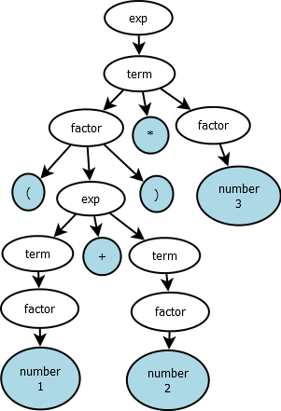
Semantic Analysis
Semantics is all about meaning. It cannot be just defined for language but also can be defined for many different things such as arithmetic expressions.
Consider the following expression.
(5 + 2) * 7 = 7 * 7 = 49
The meaning that can be derived from the above expression is as follows :
The expression is nothing but a multiplication of 2 numbers in which the first number consists of addition of 2 numbers.
ans = mult (add (4, 3), 7)

Slide 9
Semantic Analysis
Linguistic : Linguistic meaning refers to the actual meaning of the sentence and it does not convey any emotions to the audience.
For example : It is 8pm.
The above sentence can be plainly interpreted as :
The time is 8pm.
Pragmatic : Dealing with things sensibly and realistically in a way that is based on practical rather than theoretical considerations.
For example : It is the time to leave.
The above sentence does not determine the actual meaning of the sentence but tries to convey hidden emotions behind it. This sentence cannot stand by itself but would need help of some underlying sentence. If we combine the above example, then we can derive a clear hidden meaning of the sentence along with its emotions
The time is 8pm. It is the time to leave.

Slide 10
Semantic Analysis
Semantic analysis can be achieved in the following manner :
Assign each word some sort of a meaning and combine the meanings of the words with others to form a phrase, sentence, paragraph or a story, etc.
For example : I bought a book
We can interpret the above sentence as follows :
Buying(buyer = speaker, boughtItem = book)
Entailment : In entailment one fact follows the other.
For example : 1. All cats have whiskers.
2. Tom is a cat.
We can interpret the above sentence as follows :
Tom has whiskers.
Presupposition : We draw some conclusions based on the sentence
For example : The queen of Utopia is dead
conclusion : Utopia had a queen before.

Slide 11
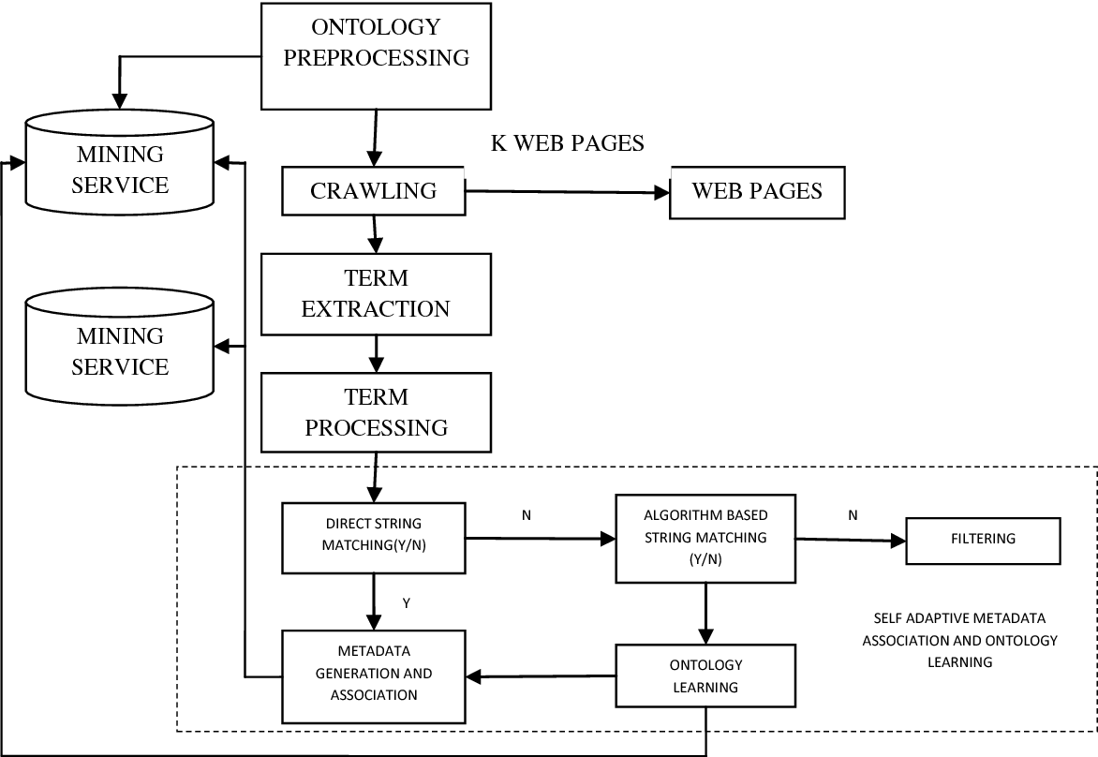
Flowchart for Web Based Semantic Analysis

Slide 12
Sentimental Analysis
Sentiment Analysis also known as Opinion Mining is a field within Natural Language Processing (NLP) that builds systems that try to identify and extract opinions within text.
Sentiment Analysis is the most common text classification tool that analyses an incoming message and tells whether the underlying sentiment is positive, negative our neutral.
Currently, sentiment analysis is a topic of great interest and development since it has many practical applications. Since publicly and privately available information over Internet is constantly growing, many texts expressing opinions are available in review sites, forums, blogs, and social media.
With the help of sentiment analysis systems, this unstructured information could be automatically transformed into structured data of public opinions about products, services, brands, politics, or any topic that people can express opinions about.
This data can be very useful for commercial applications like marketing analysis, public relations, product reviews, net promoter scoring, product feedback, and customer service.

Slide 13
Sentimental Analysis
Types of Sentimental Analysis :
1. Fine-grained Sentiment Analysis : gives being more precise about the level of polarity of the opinion.
Very positive, Positive, Neutral, Negative, Very negative. (Star rating on playstore or faculty feedback.)
2. Emotion detection : Emotion detection aims at detecting emotions like, happiness, frustration, anger, sadness, and the like.
3. Aspect-based Sentiment Analysis : Along with sentiments the subject is also focused upon.
"The battery life of this camera is too short."
The sentence is expressing a negative opinion about the camera, but more precisely, about the battery life, which is a particular feature of the camera.
4. Intent Analysis : detects what people want to do with a text rather than what people say with that text (request, question, claim, etc.)
5. Multilingual sentiment analysis : Makes the use of resources available online such as sentimental lexicons, etc.

Slide 14
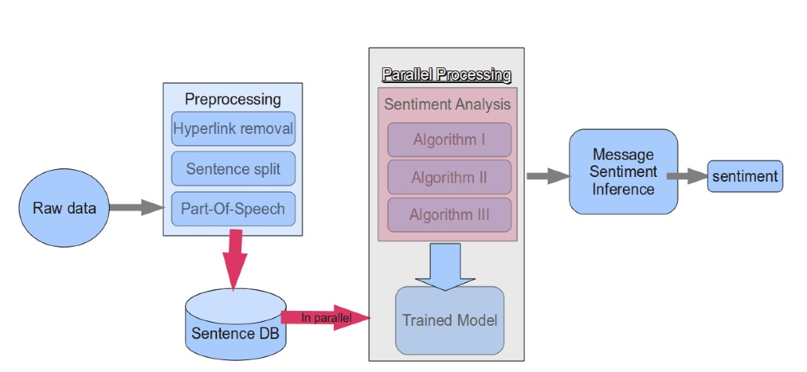
Flowchart for Sentimental Analysis

Slide 15
Applications of Semantic Analysis
Translator tool : Can be used to translate languages.
Relevancy detector : Can be used to get the exact meaning of the sentence.
For example : Apple works good. : (Apple company is referred here.)
I had an apple. : (Apple fruit is referred here.)
Smart Compiler Design : As we all know that semantic analysis has a important role in compiling phases, it can be used to design a smart compiler.

Slide 16
Applications of Sentimental Analysis
The Role of Sentiment Analysis in Business : Product feedback and analysis model. Can be used to improve products.
Understand customer trends : Organizations can take a decision to discard or improve a particular product based on customer trends.
Sentimental analysis to understand current topics : It can be used to do analysis on current and trending topics.
Sentimental analysis in politics : To understand how many people are positive, negative or neutral

Slide 17
Conclusion
Thus, we have understood an overview about semantic and sentimental analysis.

Slide 18
References
[1.] https://en.wikipedia.org/wiki/Natural_language
[2.] https://www.expertsystem.com/natural-language-process-semantic-analysis-definition/
[3.] https://simplicable.com/new/natural-language-processing
[4. ] S. Miller, H. Fox, L. Ramshaw, and R. Weischedel. A novel use of statistical parsing to extract information from text. Applied Natural Language Processing Conference (ANLP), 2000.
[5.] S. Miller, J. Guinness, and A. Zamanian. Name tagging with word clusters and discriminative training. In Conference of the North American Chapter of the Association for Computational Linguistics & Human Language Technologies (NAACL-HLT), pages 337–342, 2004.
[6.] P. Koomen, V. Punyakanok, D. Roth, and W. Yih. Generalized inference with multiple semantic role labeling systems (shared task paper). In Conference on Computational Natural Language Learning (CoNLL), pages 181–184, 2005.

Slide 19
Thankyou.

